Slide 1
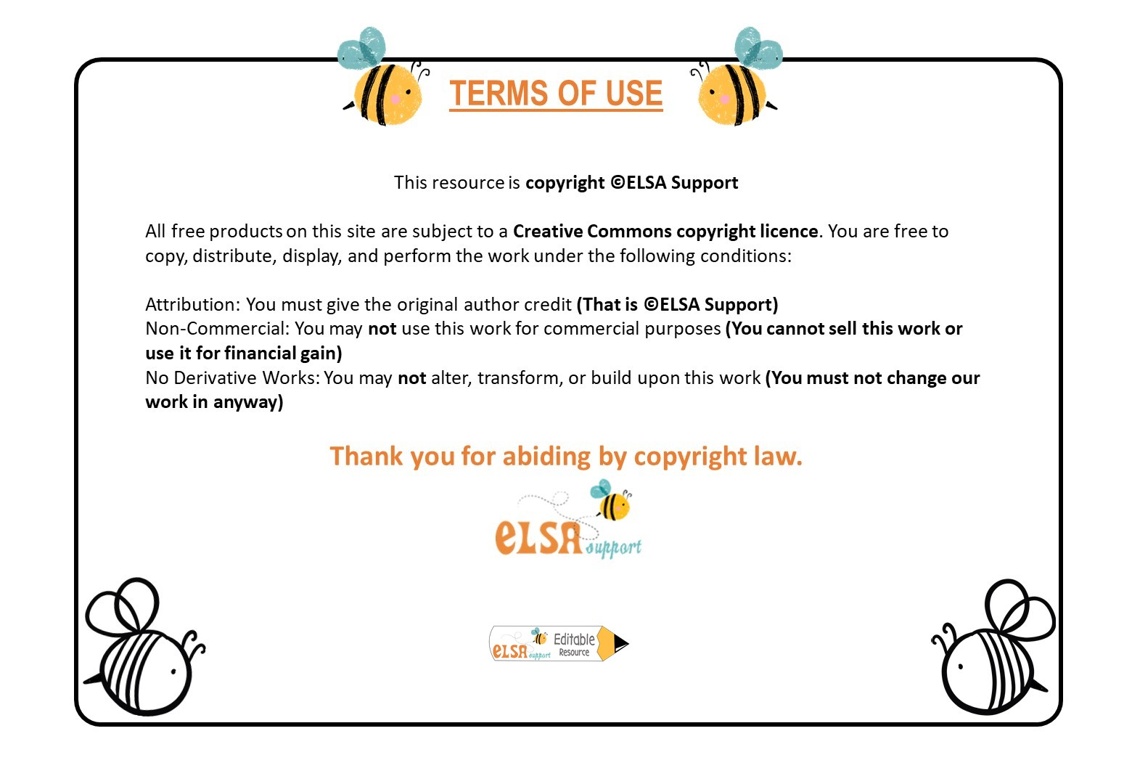
www.elsa-support.co.uk

Slide 2
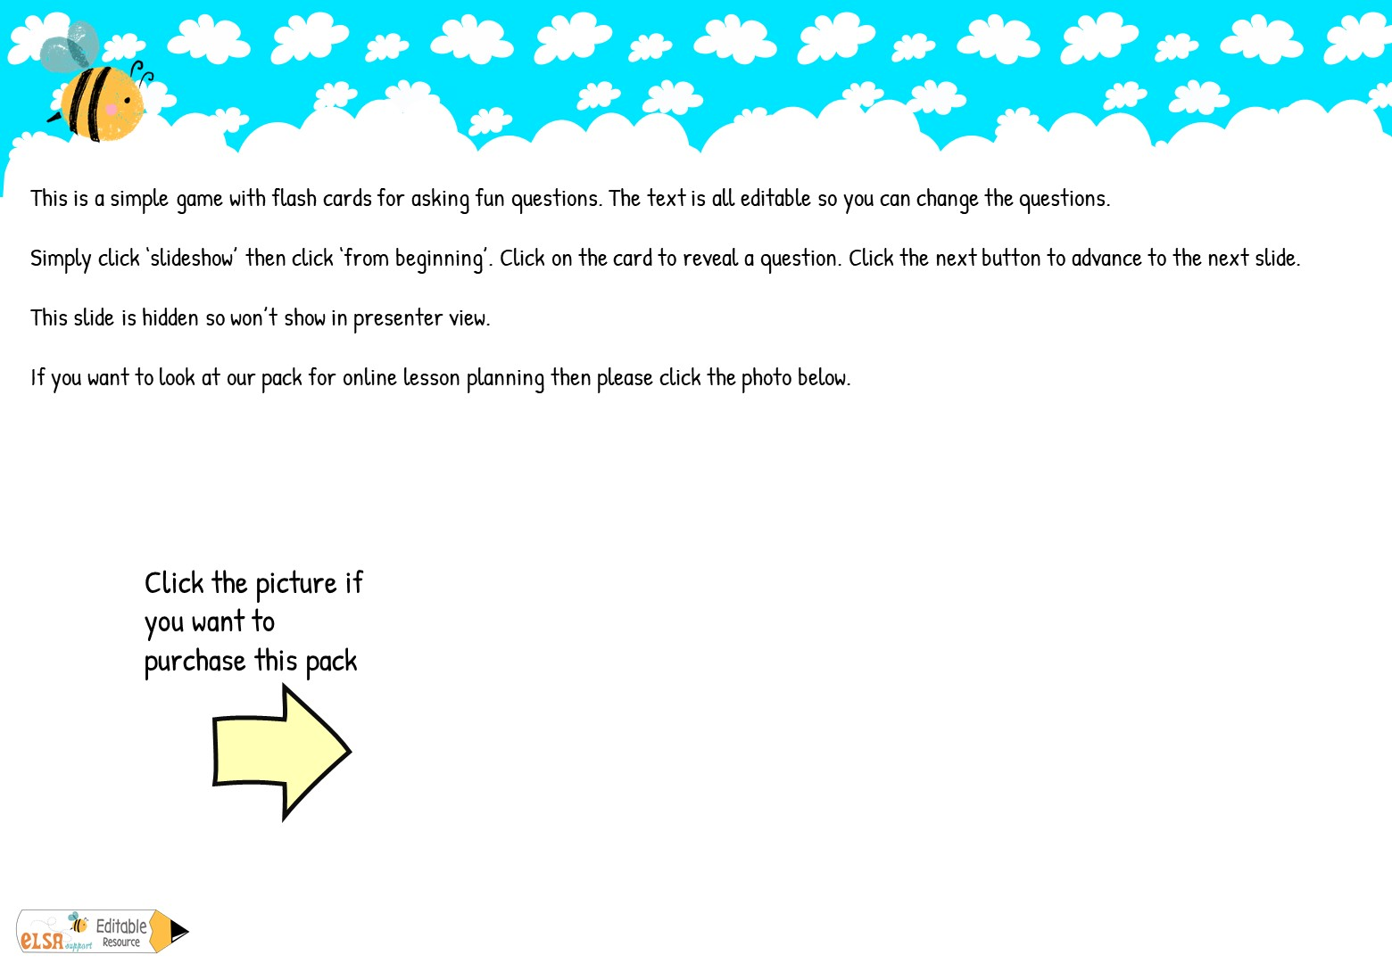
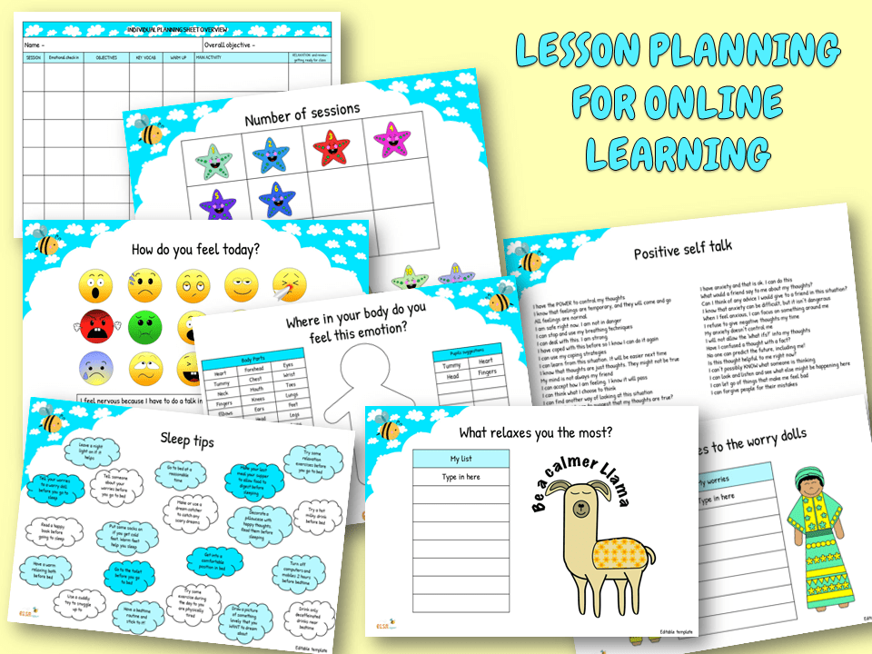

Slide 3
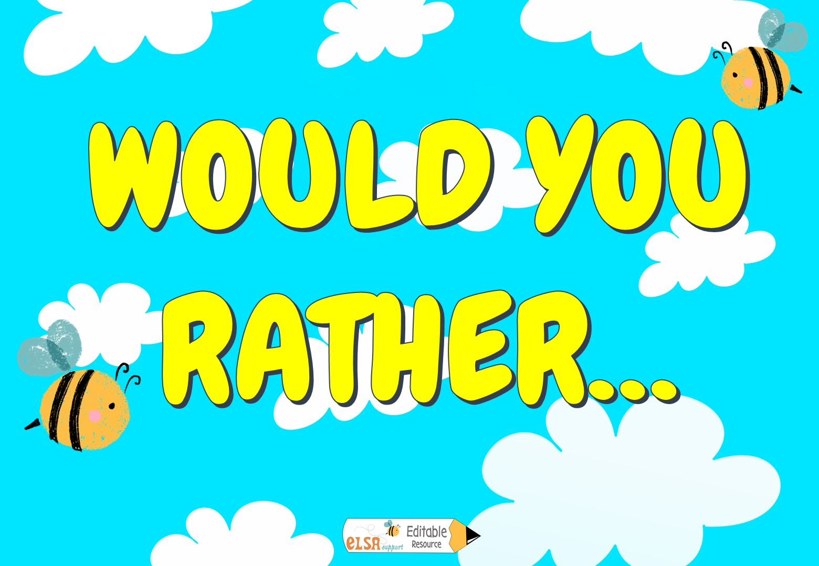
PLAY

Slide 4

Sing or dance?
Would you rather…
Would you rather…
Would you rather…
Would you rather…
Swim or fly?
Run or walk?
Stand or lay down?
Would you rather…
Would you rather…
Drink or eat?
Would you rather…
Whisper or shout?
Draw or write?
Would you rather…
Read or paint?
NEXT

Slide 5

Be a bird or a fish?
Would you rather…
Would you rather…
Would you rather…
Would you rather…
Be a cat or dog?
Be a sheep or a cow?
Be a horse or a unicorn?
Would you rather…
Would you rather…
Be a rabbit or a mouse?
Would you rather…
Be an owl or an eagle?
Be a shark or a dolphin?
Would you rather…
Be a monkey or a snake?
NEXT

Slide 6
Meet a ghost or a witch?
Would you rather…
Would you rather…
Would you rather…
Would you rather…
Be a doctor or a vet?
Have a MacDonalds or burger king?
Have Pizza or Fried chicken
Would you rather…
Would you rather…
Be a famous singer or actor?
Would you rather…
Fly or be invisible?
Have hot chocolate or coffee?
Would you rather…
Eat chips or mash?
NEXT

Slide 7
Be rich or poor?
Would you rather…
Would you rather…
Would you rather…
Would you rather…
Be a fairy or a unicorn?
Be a superhero or a villain?
Drink Pepsi or Cola?
Would you rather…
Would you rather…
Have a magic wand or a broomstick?
Would you rather…
Hold a spider or a slug?
Visit London or Paris?
Would you rather…
Play football or tennis?

