Slide 1
Year 6 Parents Information

Slide 2
Autumn 1

Slide 3
Autumn 1

Slide 4
Autumn 2 overview

Slide 5
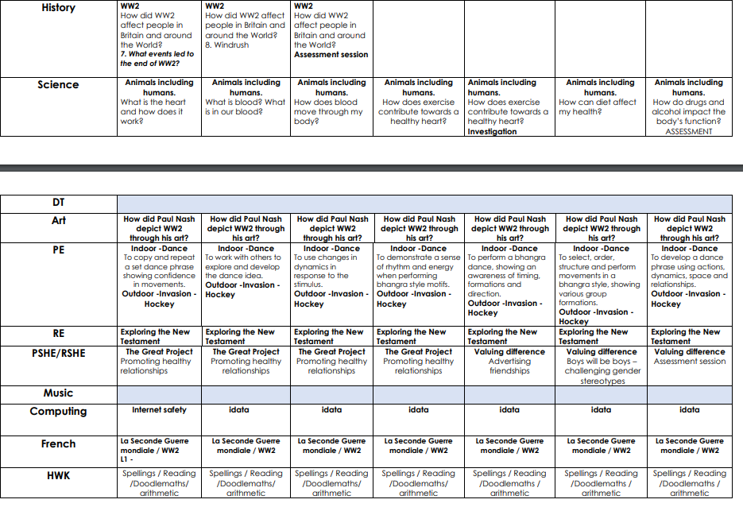
Autumn 2 overview

Slide 6
Spring Term

Slide 7
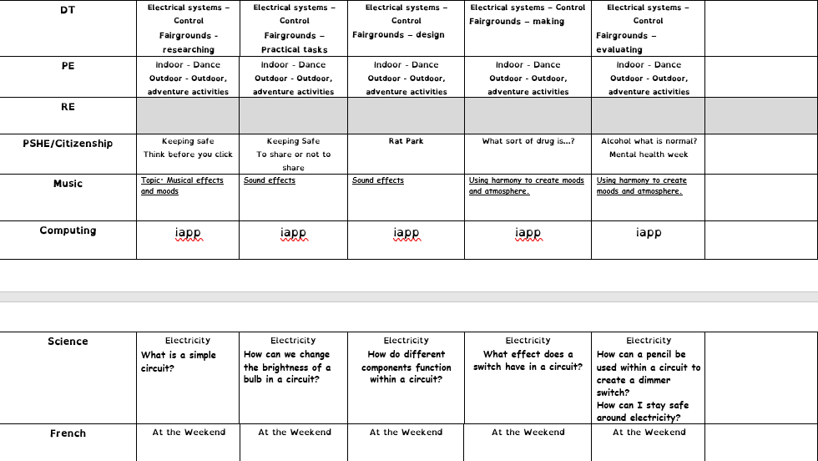

Slide 8
24

Slide 9
What are the SATS tests?
SATS week across the country begins on 13th May 2024.
Pupils will complete SATS test papers in: - Reading - Grammar, Punctuation & Vocabulary - Spelling - Arithmetic - Mathematical Reasoning – 2 papers

Slide 10
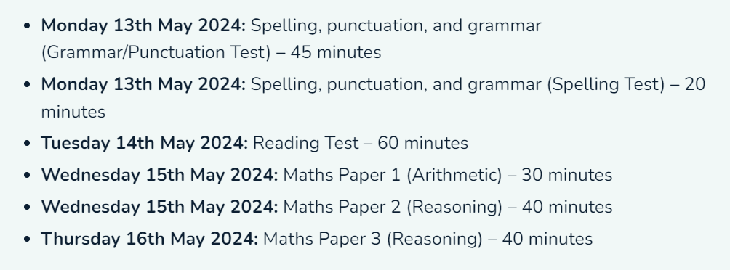

Slide 11
How do the tests take place?
In classrooms.
Test conditions.
Sent away to be marked externally.
Results are returned to school in July.
Provision for children with addition needs (scribe, rest breaks, extra time, reader)

Slide 12
The Reading Test
Comprehension paper.
The test will have three different texts to read, drawing on fiction, non-fiction or poetry.
Questions are focused around the following areas (called ‘content domains’): - give/explain the meaning of words in context - retrieve and record - summarise - make inferences from the text - predict - suggest and justify - Explain choice of words and phrases - Make comparisons within the text
There are a range of answer types, including multiple choice, short one-word answers and longer answers that require a written paragraph.

Slide 13
©Ks2history 2018

Slide 15
The GPS Tests
There are two tests: a short spelling test and a longer paper testing grammar, punctuation and vocabulary.
Questions in the grammar test are focused around the following areas (called ‘content domains’): - Grammatical terms/word classes - Functions of sentences - Combining words, phrases and clauses - Verb forms, tenses and consistency - Punctuation - Vocabulary - Standard English and formality
There are a range of answer types in the grammar test, including multiple choice and short one-word answers, but there will not be any long written answers required

Slide 16
©Ks2history 2018

Slide 17
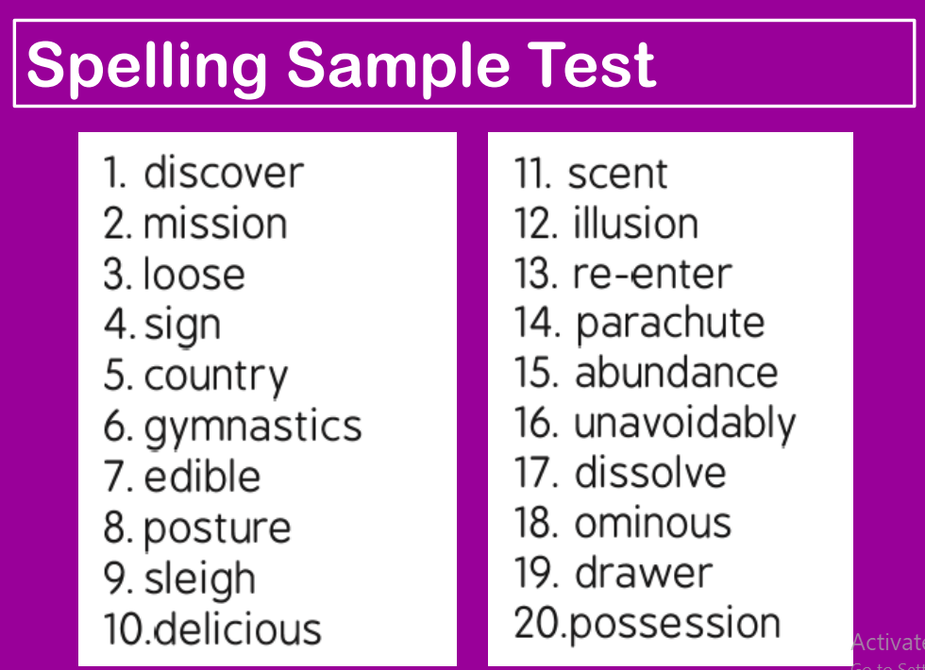

Slide 18
The Maths Tests
There are three tests: one arithmetic paper and two reasoning papers.

Slide 19
©Ks2history 2018

Slide 21
Writing Assessments
Writing is assessed throughout the year within our Awesome Authors challenges.
10 pieces of the children’s writing will be chosen as evidence for their final grade.
The teacher will moderate their assessments with other professionals to make sure there is a consistent standard across the country.
Final judgements will be reported to parents at the same time as the other assessment results.

Slide 22
Handwriting expectation in yr5

Slide 23
Writing Assessment objectives
See some examples of children’s work – Expected and Greater depth

Slide 25
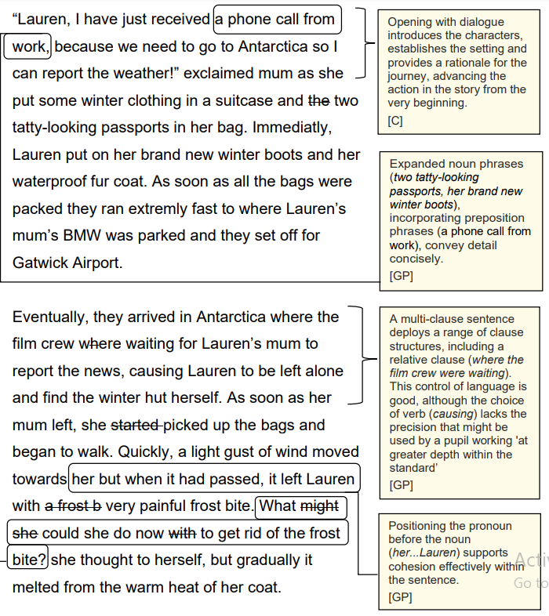

Slide 26
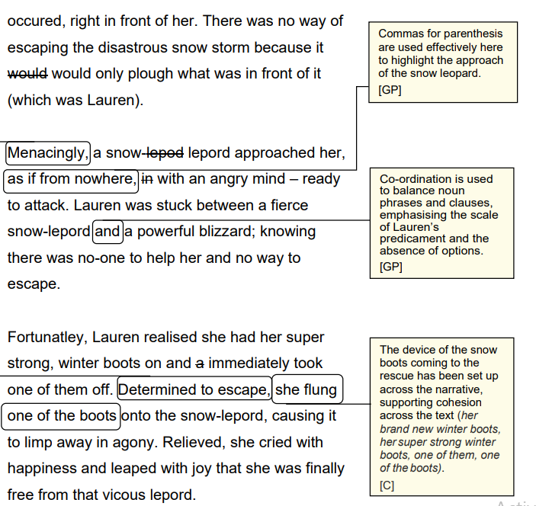

Slide 27
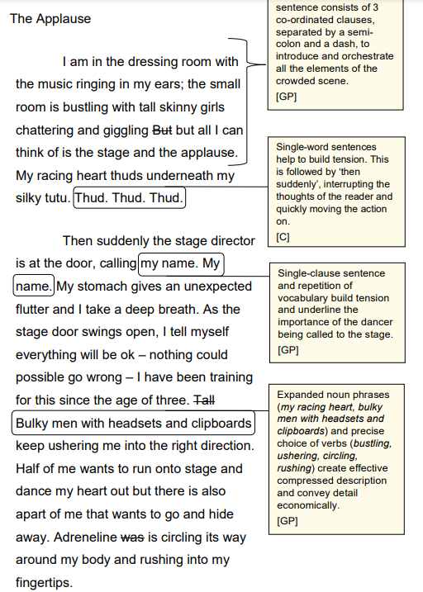

Slide 28
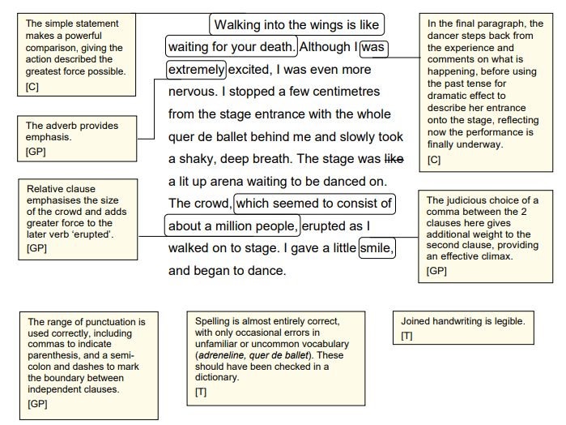

Slide 30
How can I help my Y6 child?
Help children not to feel worried or pressured about SATS. All that is asked is that they try their best, but please reassure children that the SATS should not be causing anxiety. Do give lots of praise and encouragement!
Help children with organising their homework (including spellings and maths reasoning homework) and support their reading for pleasure activities.
Help them to have early nights and a healthy diet.
Help your child to have the best possible attendance at school.
Please speak to a member of staff if you have questions or concerns.

Slide 31
SAT’s breakfast
In the morning of the tests the children will be allowed to come into school earlier to meet their friends, chat and generally chill eat whilst having breakfast.
What’s on offer?
Toast (jam)
Cereals
Pain au chocolat or croissants
Fruit
Juice
(A small donation will be asked for)

Slide 32
CGP Revision books
Approximately £2 per book.
Notes:
After Christmas and to order by Feb 1st

Slide 34
©Ks2history 2018

Slide 35
Homework
Weekly spellings
Weekly reading (x3 a week)- class target is 1000 reads. When achieved the class will have a visit to Arnold library
DoodleMaths – need to be in the ‘green zone’, rewards are given in assemblies for class achievement
Weekly arithmetic or reasoning practice paper (maths) Monday’s
Lexia (selected children)
Times Tables Rockstars

