Slide 2
WB 20.2.23
dappled
insignificant
perplexed
sill
absent
rasp
surged
departed

Slide 3
dappled
Marked with spots or rounded patches.
speckled
dotted
flecked

Slide 4
insignificant
Too small or unimportant to be worth consideration.
unimportant
meaningless
trivial

Slide 5
perplexed
Completely baffled or very puzzled.
puzzled
baffled
confused

Slide 6
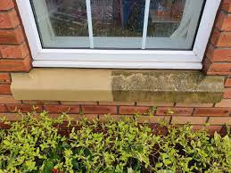
sill
A shelf or slab of stone, wood, or metal at the foot of a window opening or doorway.
sill

Slide 7
absent
When someone or something is not there.
2) When someone is not paying attention.
away
off
distracted

Slide 8
rasp
A harsh, grating noise.
grind
scrape
grate

Slide 9
surged
To move suddenly and powerfully forward or upward.
gushed
rushed
burst

Slide 10
departed
Something that’s departed is gone or happened in the distant past.
lost
dead
gone

Slide 11
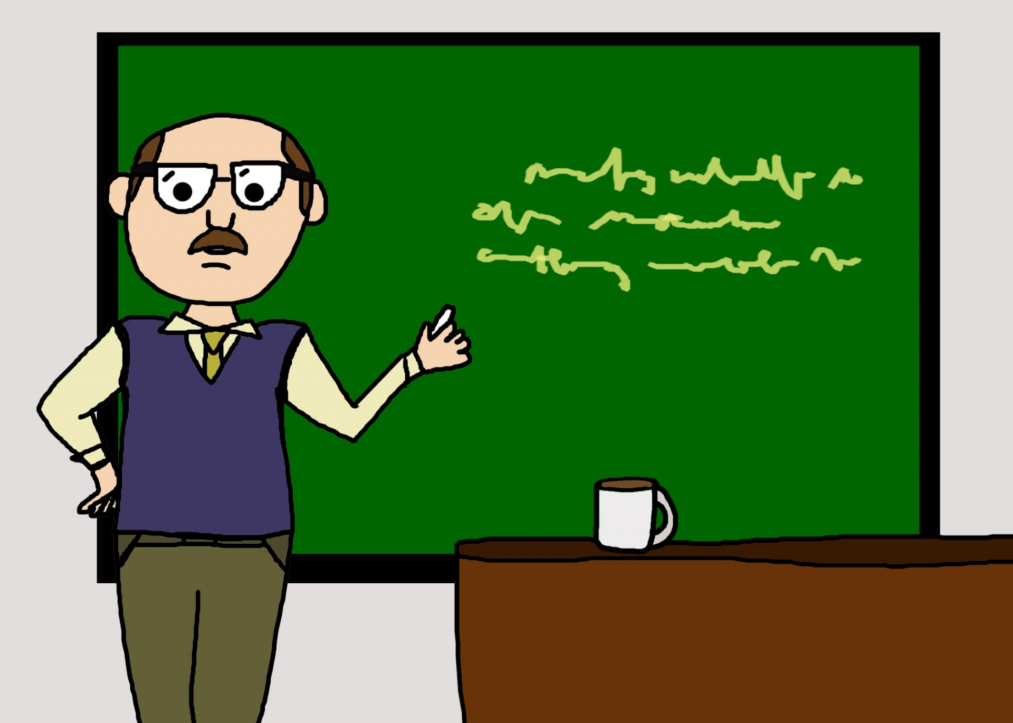
Teach me!

Slide 12
Definition match
dappled
insignificant
perplexed
sill
absent
rasp
surged
departed

Slide 13
Reading
Teacher modelled
Shared reading

Slide 14
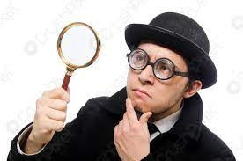
Can you find and highlight the tier 2 words in your text?

Slide 17
away
grind
unimportant
dead
absent
rasp
surged
departed
dappled
insignificant
perplexed
sill
rushed
speckled
scrape
distracted
baffled
meaningless
gushed
flecked
lost
confused

Slide 18
Reading
Teacher modelled
Shared reading

Slide 19
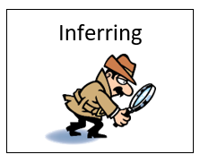
Inferring
What is ‘inferring’ and why is it important?

Slide 20
I do!
Read paragraphs 1 and 2. The traveller was in a rush. Do you agree? Use evidence from the text to support your answer.
I agree that the traveller was in a rush. I think this is true because in the text it says he ‘leapt forward and rapped the door angrily’. This implies that he wanted someone to answer the door.

Slide 21
We do!
What does the phrase “with anger in his fist” tell you about how he knocked on the door?
????????????????????????/

Slide 22
You do!
What does the phrase “with anger in his fist” tell you about how he knocked on the door?
What does the word “absent” tell you about the listeners answer?

Slide 24
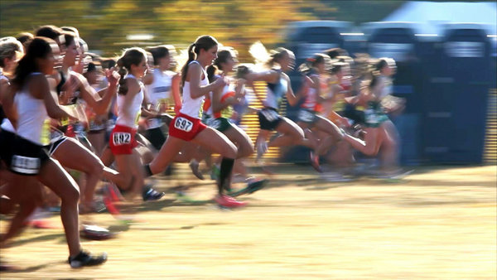
Synonym race!

Slide 25
WB 20.2.23
dappled
insignificant
perplexed
sill
absent
rasp
surged
departed

Slide 26
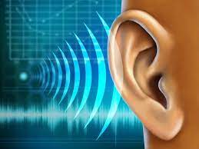
Echo reading

Slide 27
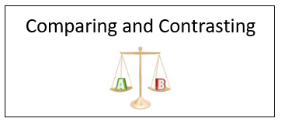
Comparing and contrasting
What is ‘comparing and contrasting’ and why is it important?

Slide 28
We do!
Traveller’s attitude at the beginning- (find a sentence to say how he felt when he first arrived)
After he had knocked on the door he felt… ( find evidence of how he was feeling)
Traveller’s attitude by the end of the story? ( How had his feelings changed at the end?)
Answer framework-
At first the traveller felt________
After he had knocked on the door he was______
At the end his attitude changed because he no longer felt____ but now he felt ________.

Slide 29
You do!
Traveller’s attitude at the beginning- (find a sentence to say how he felt when he first arrived)
After he had knocked on the door he felt… ( find evidence of how he was feeling)
Traveller’s attitude by the end of the story? ( How had his feelings changed at the end?)
Answer framework-
At first the traveller felt________
After he had knocked on the door he was______
At the end his attitude changed because he no longer felt____ but now he felt ________.

Slide 31
Babble gabble!

Slide 32
WB 20.2.23
dappled
insignificant
perplexed
sill
absent
rasp
surged
departed

Slide 33
Reading
Teacher modelled
Echo reading
Shared reading

Slide 34
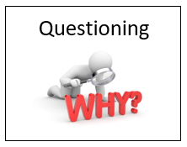
Questioning
What is ‘questioning’ and why is it important?

Slide 35
We do!
What do you think the listeners are?
???????????????????????

Slide 36
You do!
1) What do you think the Listeners are?
2) Why was the traveller desperate for the Listeners to know he kept his word?
3) Who do you think “them” is?

Slide 38
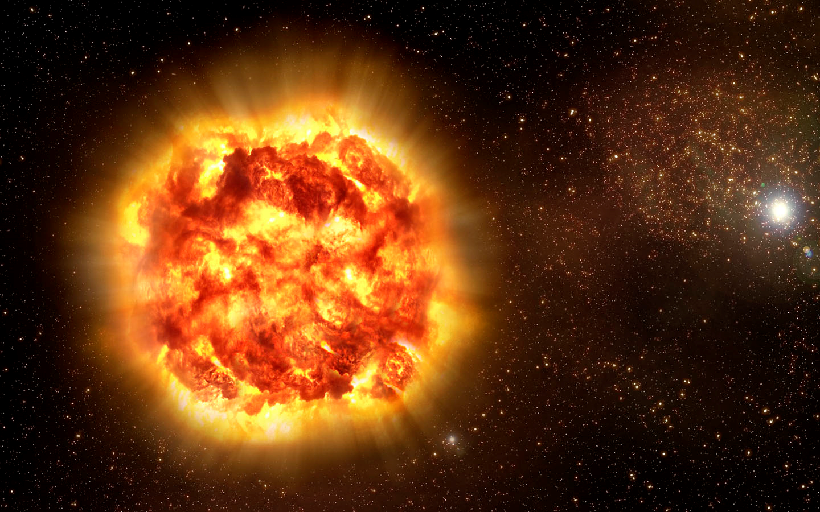
Pen blast!

Slide 39
Pen blast!
dappled
insignificant
perplexed
sill
absent
rasp
surged
departed
synonyms
meaning
sentence

Slide 40
Reading
Teacher modelled
Echo reading
Shared reading

Slide 41
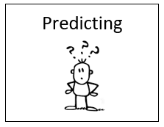
Predicting
What is ‘predicting’ and why is it important?

Slide 42
We do!
What do you think happened to the Traveller at the end of the story? Use evidence from the text to support your answer.

Slide 43
You do!
What do you think happened to the Traveller at the end of the story? Use evidence from the text to support your answer.

