Slide 1

www.elsa-support.co.uk

Slide 2

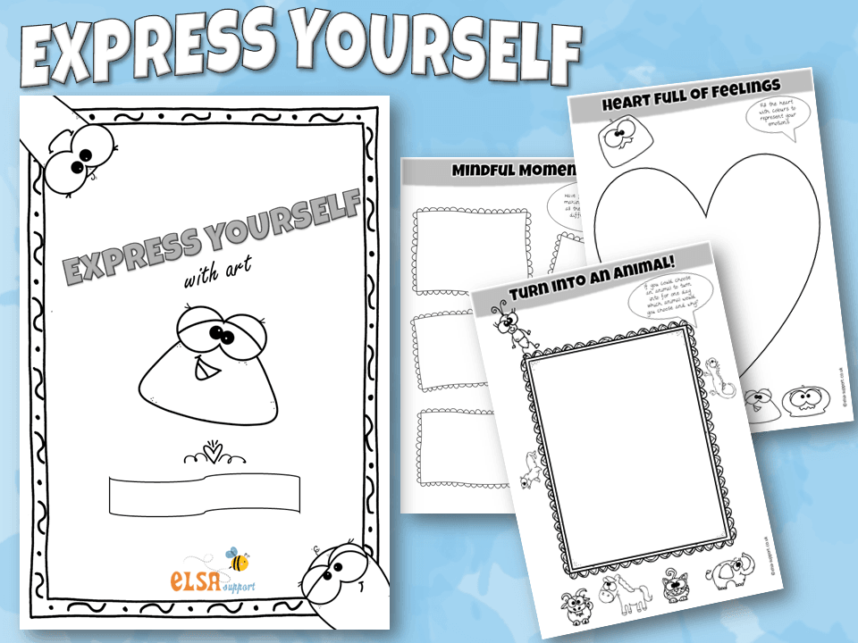

Slide 3

Express yourself Emotion charades
Think about the emotion you might express in response to these situations. Can you act out the facial express and body language you might have. Think about what you might say or do in each situation
1
2
3
4
5
6
You just lost a game
You just won a game!
You are meeting a new person
You scored a goal
You have to eat a vegetable you hate
Your friend has new trainers and you can’t afford any
7
8
9
10
11
You weren’t invited to a party
Your teacher LOVES your painting
You won a running race
You stood in dog poop
One of your classmates was making fun of your new haircut
Your teacher is talking about trains and you hate trains
12
13
14
15
16
17
You don’t have anyone to play with
You saw someone laughing at you
You were told off for something you didn’t do
You heard a strange noise when you were laid in bed
It’s your birthday today
Your teacher unexpectedly tells you all that you are going on a trip
18

