Slide 1
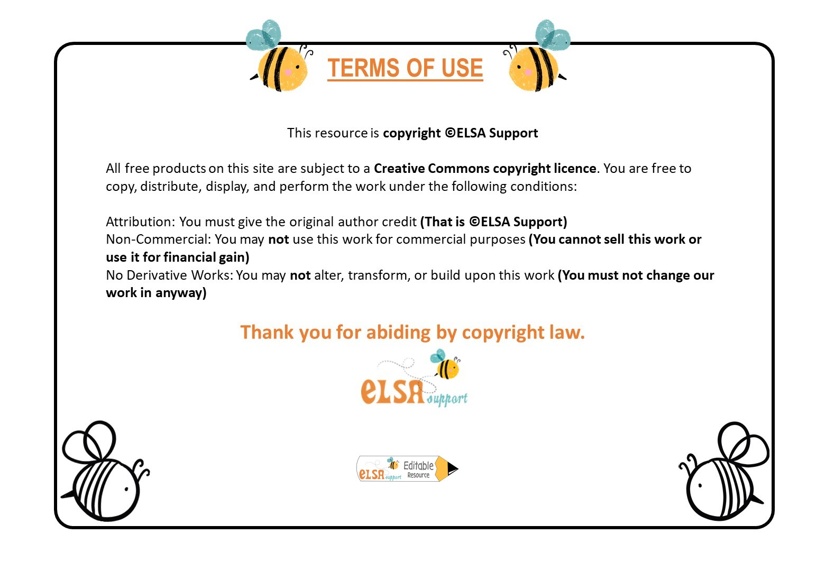
www.elsa-support.co.uk

Slide 2
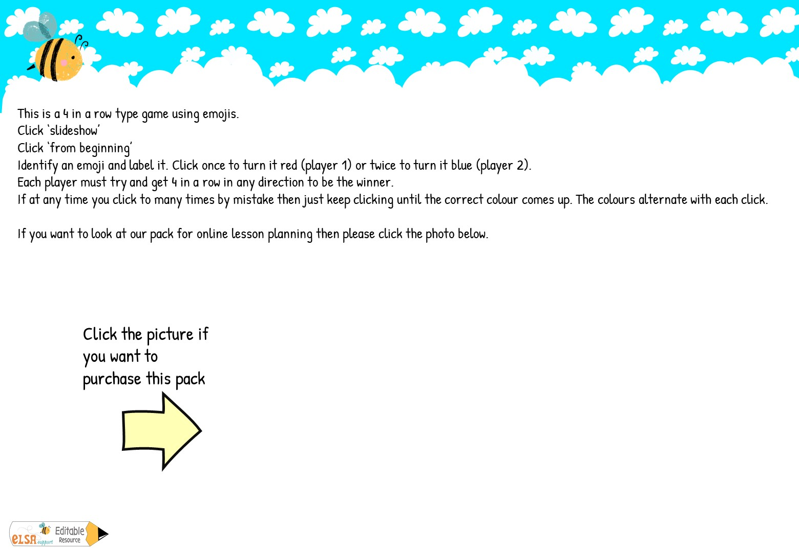
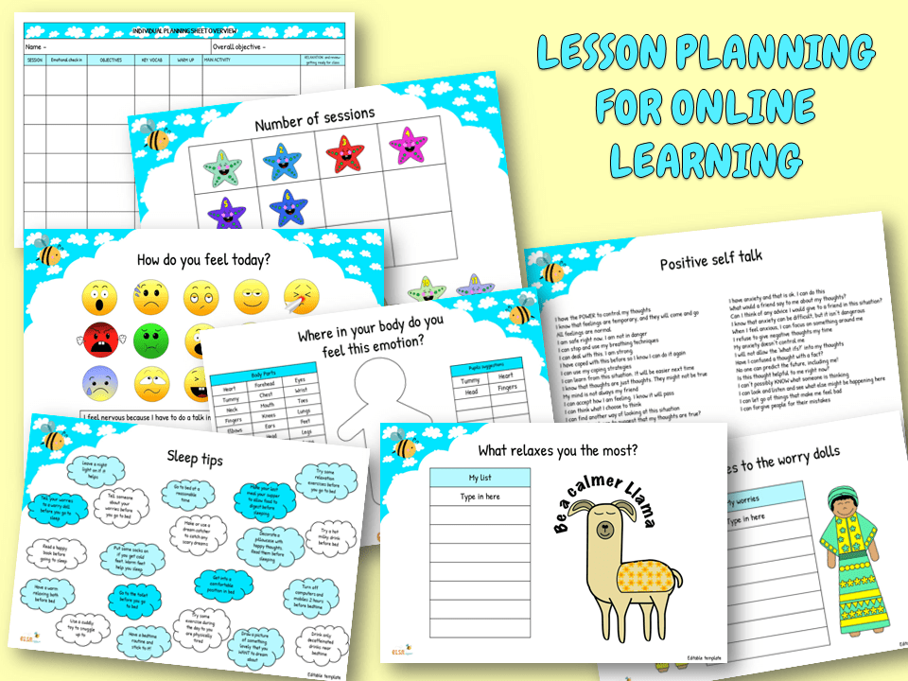

Slide 3
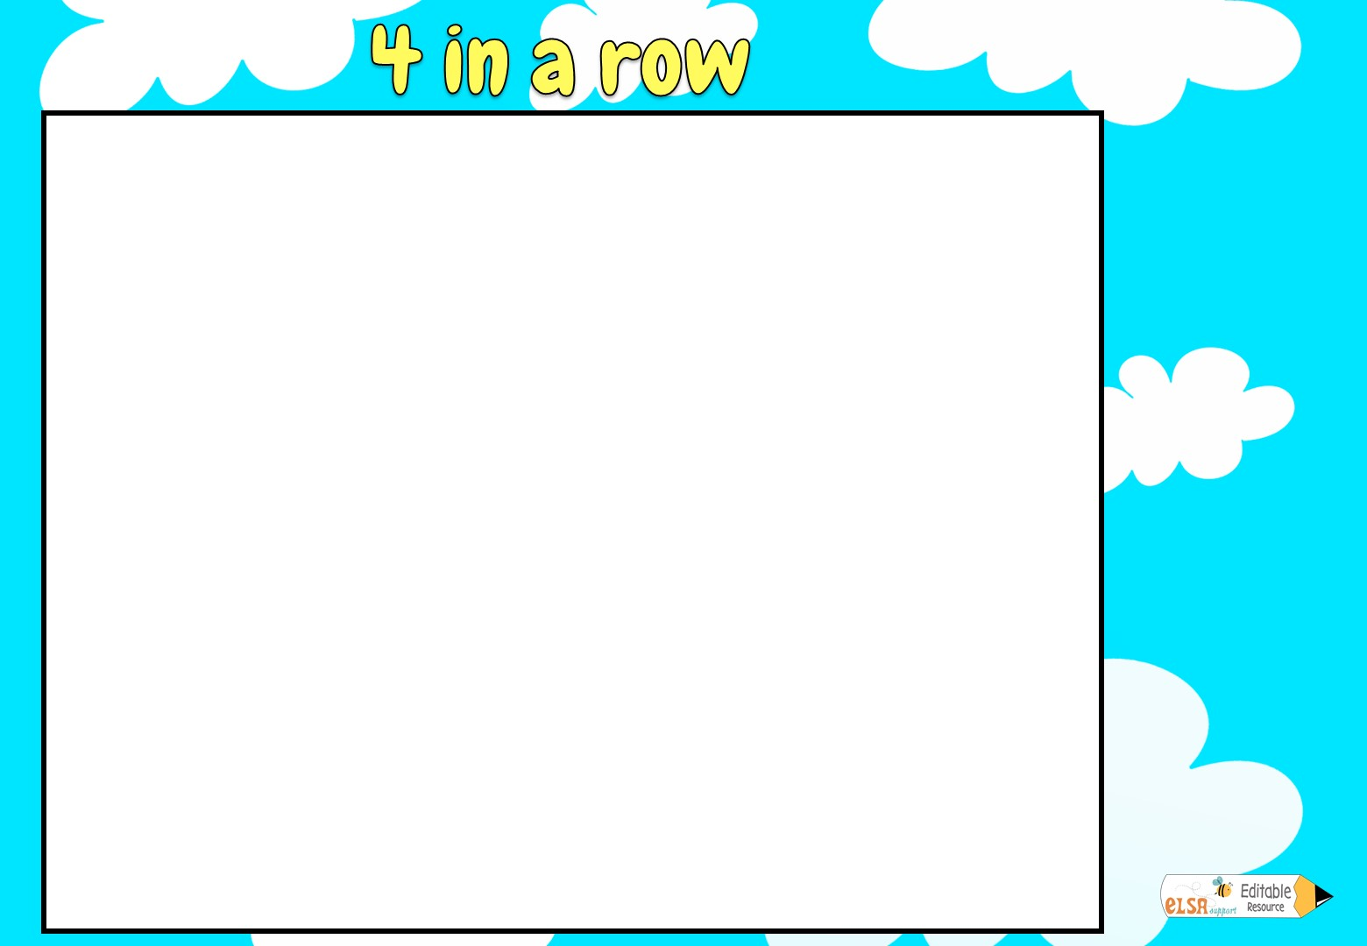




















Choose an emotion and name it!
Click once for red
Click twice for blue
Can you get 4 of your colour in a row?

