Slide 1
www.elsa-support.co.uk

Slide 2
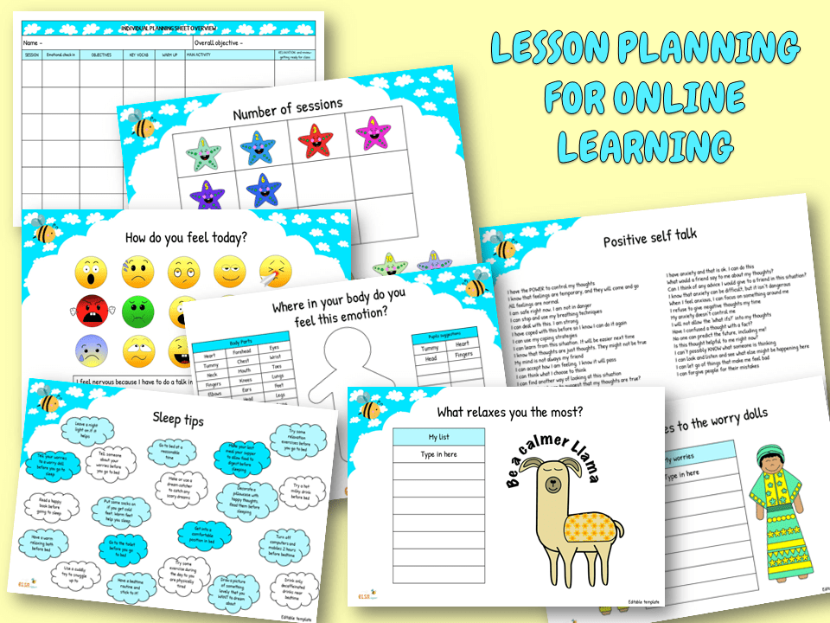

Slide 3
2
2
0
1

Slide 4
2
People you want to get to know better

Slide 5
0
Something you want to give up

Slide 6
2
Things you want to get better at

Slide 7
1
Way to show kindness

